Slide 1
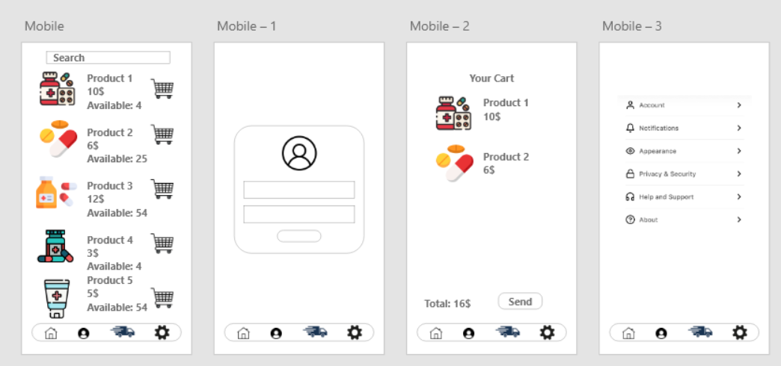


Pharmacy App
Made by: Lyubomir Romanov 201224019
Georgi Gyurov 201224018

Slide 2


Our team
Georgi Gyurov
201224018
Lyubomir Romanov
201224019

Slide 3
1. Project Overview
The project is a mobile pharmacy application that allows users to browse medicines, view availability, manage their cart, place orders, and access personal settings. The goal is to create a clean, intuitive user experience supported by a solid backend architecture and database.
The system includes:
A user authentication module
A medicine catalog
Cart and order management

Slide 4

2. Development Stages
Stage 1 — Planning & Requirements
Defined the main features: browsing products, adding to cart, viewing availability, creating orders, and managing accounts.
Identified user roles: customer, admin/pharmacist.
Designed the basic structure of the mobile app (navigation bar, product list, cart page, account page).
Stage 2 — UI/UX Design
Created wireframes for:
  Home/Product List
  Login Page
  Cart Page
  Account/Settings Page
Designed consistent bottom navigation with icons:
  Home
  Profile
  Delivery
  Settings

Slide 5

Stage 3 — Database Design
Created an initial database to store:
  Users
  Medicines
  Inventory
  Cart items
  Orders

Slide 6
Stage 4 — Backend Logic
Implemented user authentication (login, password validation).
Implemented product retrieval & search.
Implemented cart system:
  Add/Remove items
  Quantity update
Implemented order creation and total calculation.
Stage 5 — Frontend Development
Built screens according to the UI design.
Integrated backend logic with the user interface.
Ensured responsive behavior across mobile layouts.
Stage 6 — Testing
Tested user login flow.
Tested adding products to cart.
Validated calculation of totals.
Checked database relations and data consistency.
Stage 7 — Final Review & Presentation
Prepared documentation.
Finalized UI screens.
Organized responsibilities and contributions.

Slide 7
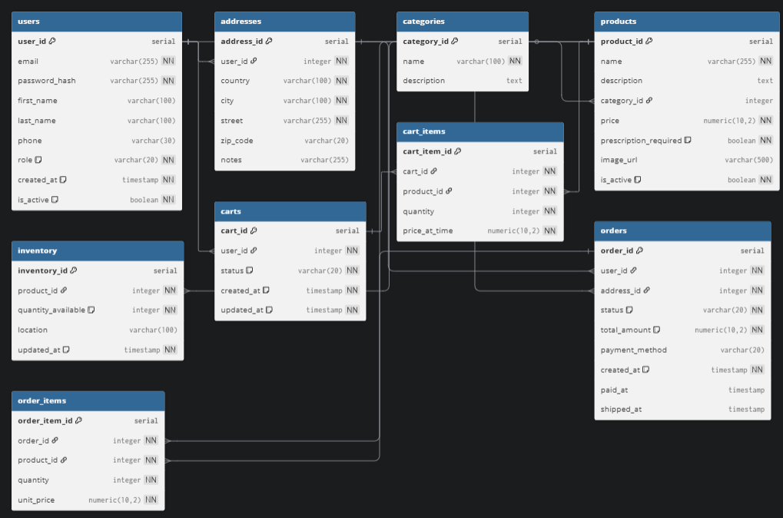
3. Database UML

Slide 8
4. Task Distribution Between Team Members
Lyubo’s Responsibilities
Database architecture
  Designing tables, relations, and structure
  Ensuring normalization and integrity
Implementation of main backend functionality
  User authentication
  Product fetching & search
  Cart functionality (add, remove, update)
UI implementation for:
  Home/Product list
  Login screen
  Cart page
Testing database logic and backend flow
Georgi’s Responsibilities
UI/UX design
  Creating mobile app screens
  Style, icons, navigation bar, spacing
Frontend implementation
  Building the Settings page
  Building the Account page
  Integrating API calls into the UI
Order processing flow
  Handling the "Send" button
  Displaying total order value
  Visual adjustments, animations, consistency checks

Slide 9
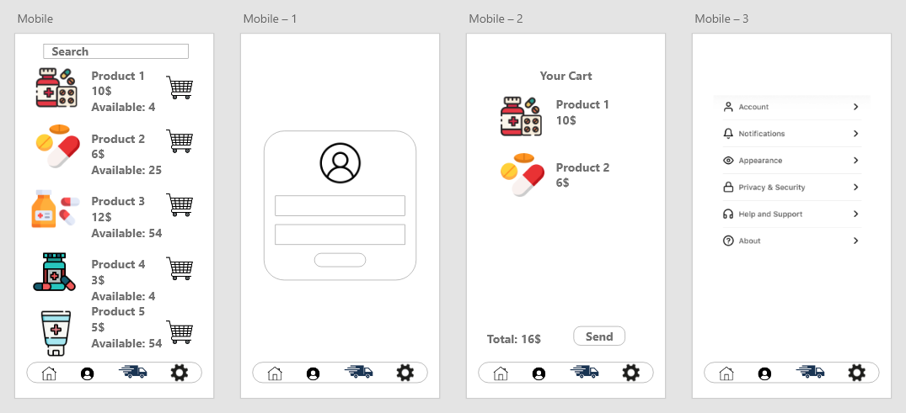
5. Conclusion
The pharmacy mobile application demonstrates a complete workflow from browsing products to placing an order. The system is supported by a clean database design, efficient backend logic, and intuitive user interface. The division of responsibilities ensured an organized workflow and smooth development process.

Slide 10
Thank you for your attention

